Slide 1
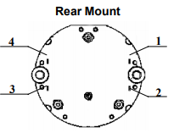
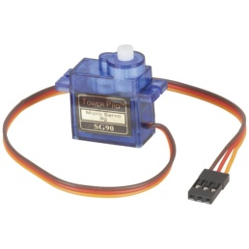


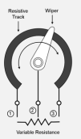
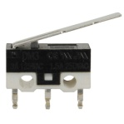
COIL1 1
COIL2 2
COIL3 3
COIL4 4
1
2
3
6
5
4
SERVO + 6
SERVO - 5
SERVO SIG 7
8
7
GN - 1
GN + 2
RD - 3
RD + 4
1
2
3
4
POT + 1
WIPE 2
POT - 3
SW + 4
SW - 5
1
2
3
6
5
4
8
7
BACKLIGHTING 12VDC
BL - 7 (12V)
BL + 8 (12V)

